Slide 1
2025 1st Half internship program
Farewell session
FG-AP-52 / INTERNS

Slide 2
2025 1st half internship Overview
Schedule | Jan. | Feb. | Mar. | Apr. | May. | Jun.
Donghyun
Both
Betty
AWS Proxy to Firewall
Role-playing Preparation
GAIA Champion Conference
GAIA Webinar
Datadog CR
GAIA Session
Learn to GR
AMIN (Automated Monthly Invoice Notifications) Development
PSD (Patch Status Dashboard) Development
GR
Infrastructure Daily Meeting & Budget Meeting & Team Meeting
Onboard & Handover
C/F/P Visit
Cloud Study
Team building
SAP RISE UAT
VDC Visit
DC Visit
AWS Summit
PR & PO
Learn to PR & PO
2025 1Q Newsletter
CDH Data Manul Input Support
2025 2Q Newsletter
Auto-monitoring Development
IDS Rollout Support
Team Workshop
NSC Facing Workshop
IDS Dealer Manual Creation
MyDMS Dealer CCB
SWOT Preparation
RDC Visit
GCS (GETCHA Scraper) Development

Slide 3
IT BUDGET & TEAM BETTY SHIN
FG-AP-52

Slide 4
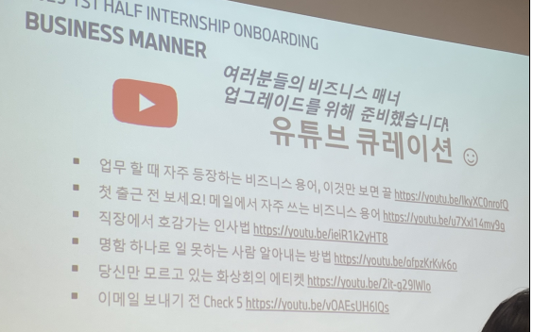
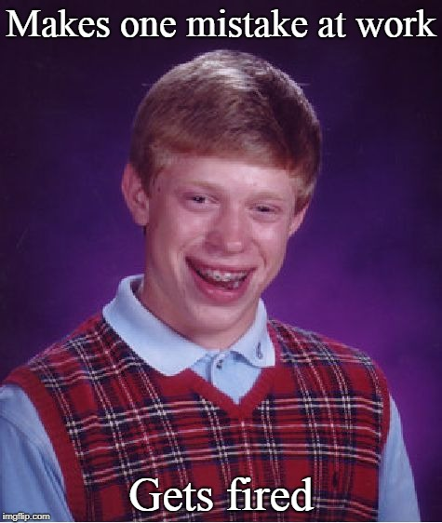
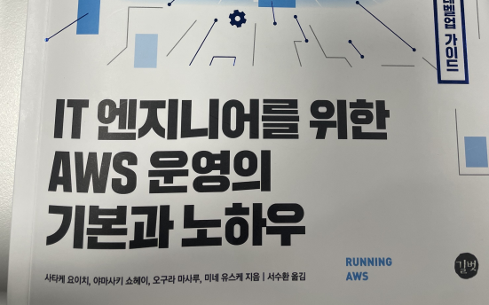


My INITIAL goals for the internship
NOT MAKING MISTAKES IN SCIAL LIFE
NOT MESSING UP MY TASKS
FIGURE OUT WHAT TO STUDY/IMPROVE MORE
Haven’t chosen my career path yet.
Software Engineer?
Become Public School Teacher?
Go to Graduate School?
Change My Major?
First Internship in my life! What if I call my boss in wrong name..? What if …?

Slide 5
What I’ve done Over the Past 6 Months
Schedule | Jan. | Feb. | Mar. | Apr. | May. | Jun.
Tasks
Infrastructure Daily Meeting & Budget Meeting & Team Meeting
PR & PO
Auto-monitoring Development
GCS (GETCHA Scraper) Development
Cloud Study
2025 1Q Newsletter
2025 2Q Newsletter
Team building
SAP RISE UAT
VDC Visit
DC Visit
AWS Summit
CDH Data Manul Input Support
IDS Rollout Support
Team Workshop
NSC Facing Workshop
IDS Dealer Manual Creation
MyDMS Dealer CCB
SWOT Preparation
RDC Visit

Slide 6

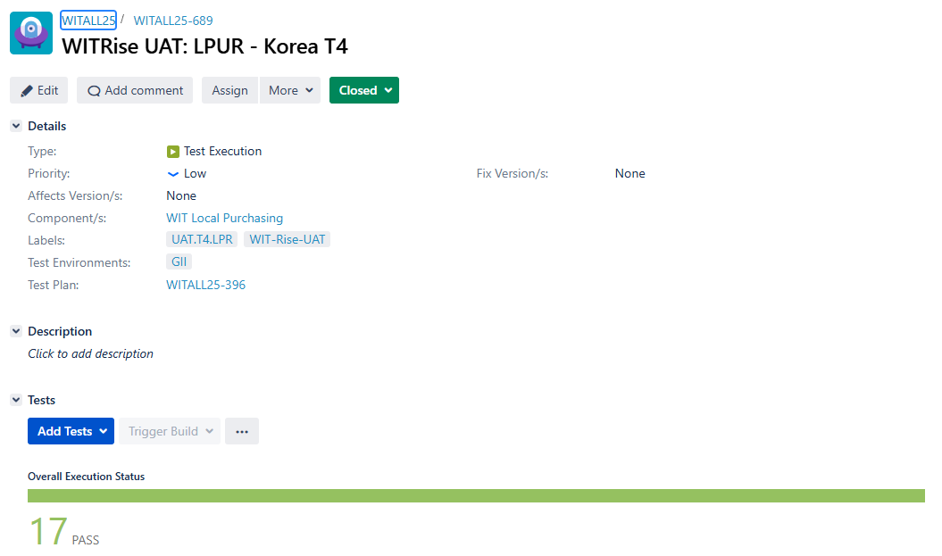

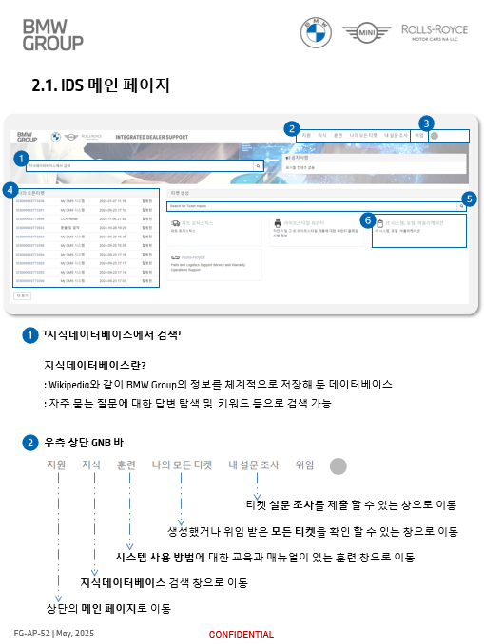
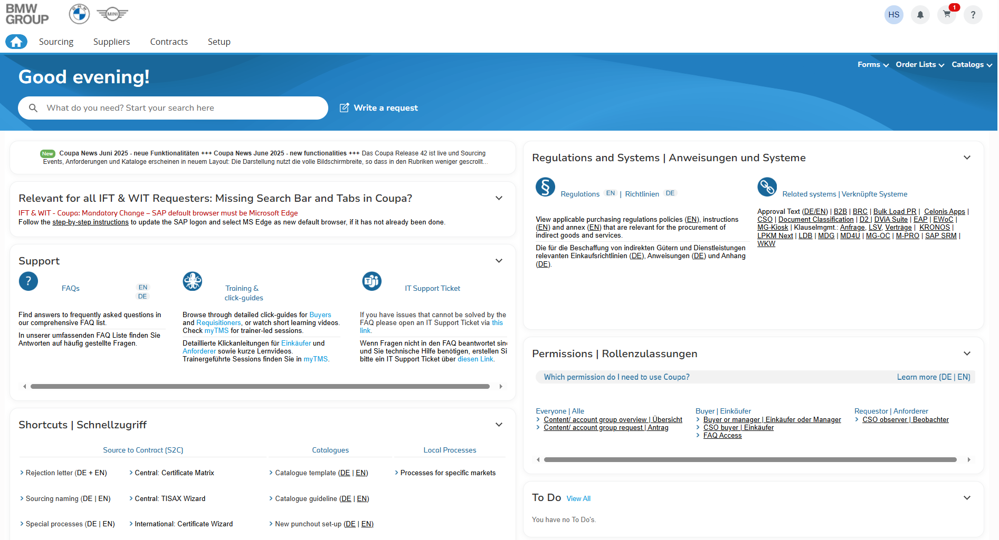
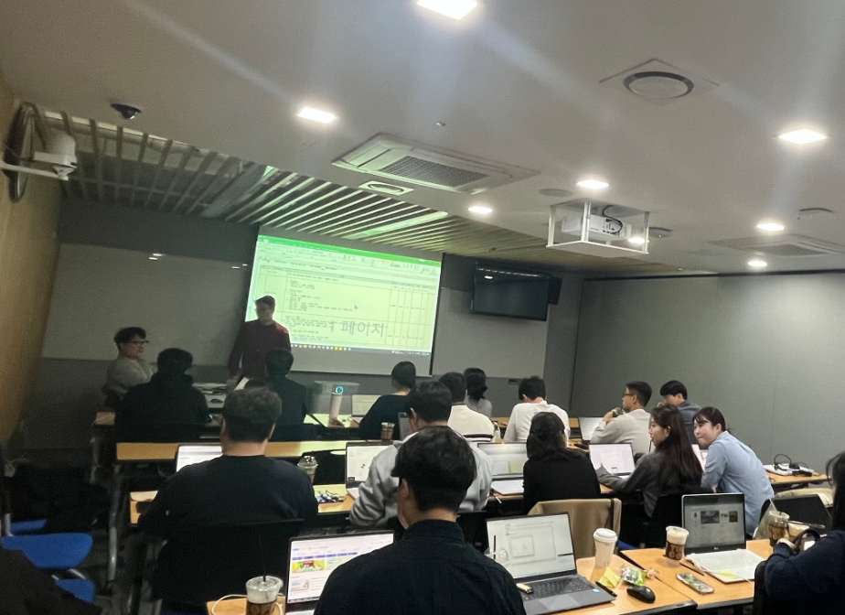
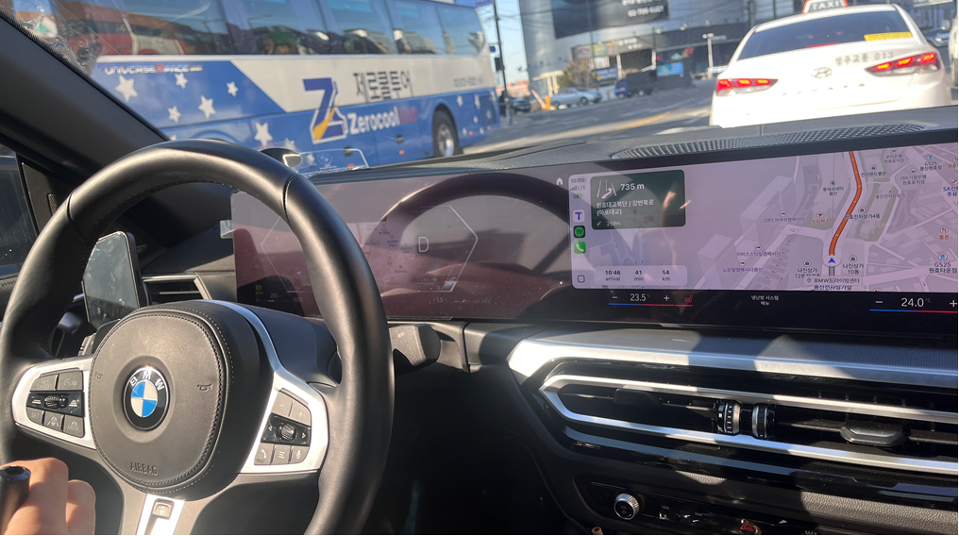
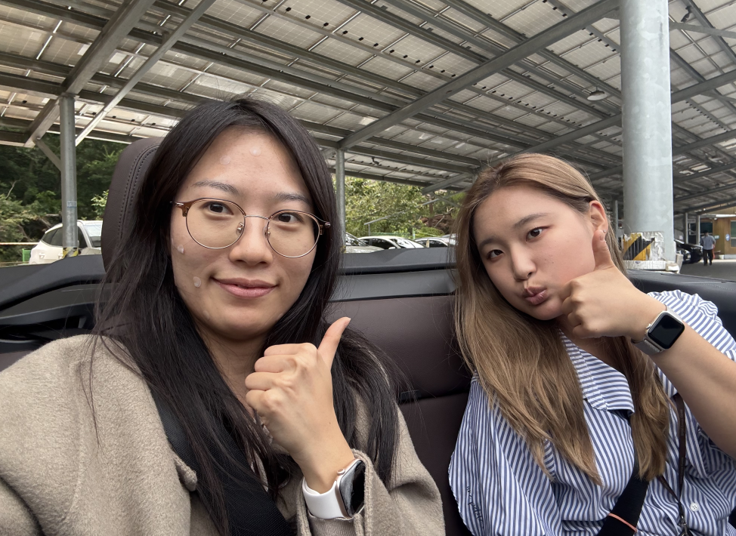
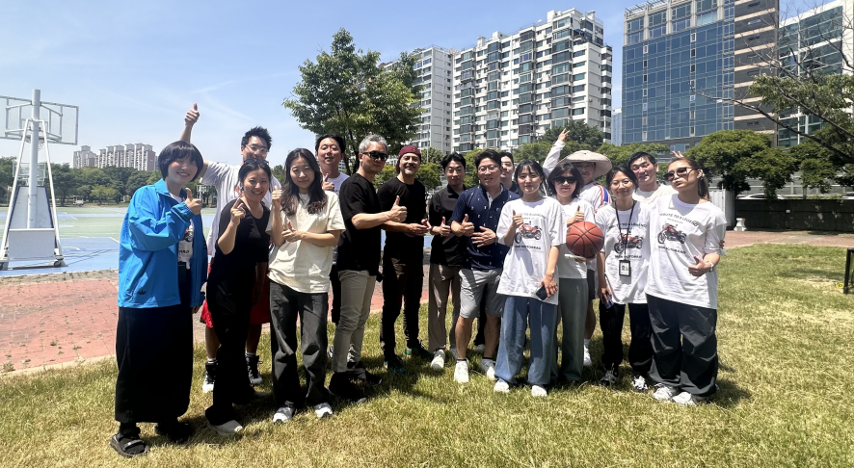
PR & PO
SAP RISE UAT
IDS Dealer Manual Creation
How the money flows. Anyways it’s commercial organization.
English Meeting with Colleagues Abroad!
Distributed to Numerous Dealers!
VDC & RDC & DC Visit
Team building
MyDMS Dealer CCB
See how our system is operating in person! Best Part of My Whole Internship TBH..
Brining Energy from Han River to Office!
Developer & PM & User Negotiation? Debate?

Slide 7
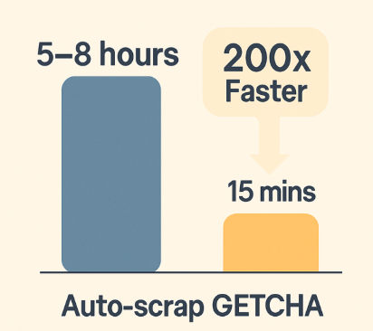
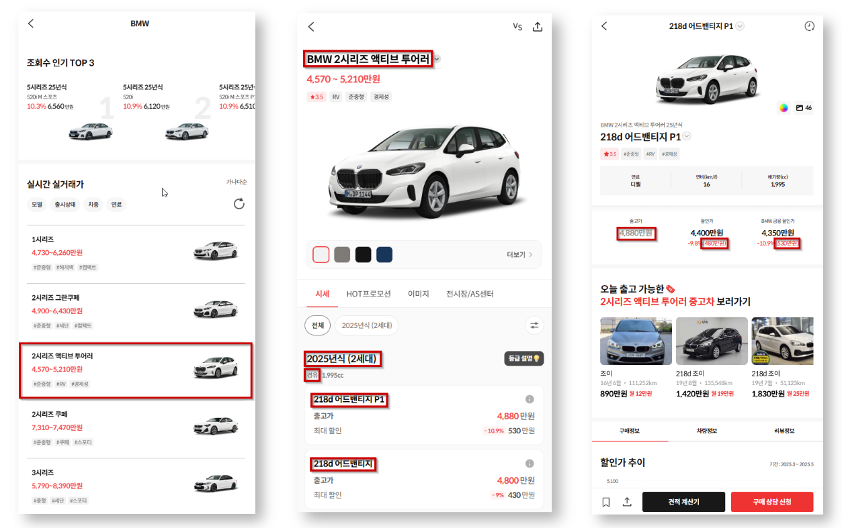
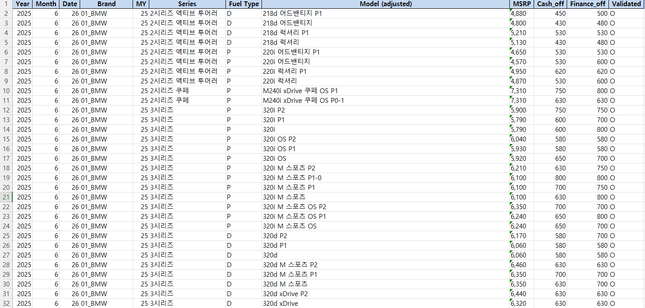
GCS (GETCHA Scraper) Development
Python-based web scraper (Similar to RPA) that automatically collects discount information for imported car brands from the GETCHA website (mobile) and saves the data as an Excel file.
https://gcs.bmwkr.ap-northeast-2.aws.cloud.bmw/
Developed started from the request of Sales Intern Wi Donghyun. Current User: Sales Manager Ryu Gayoung.

Slide 8
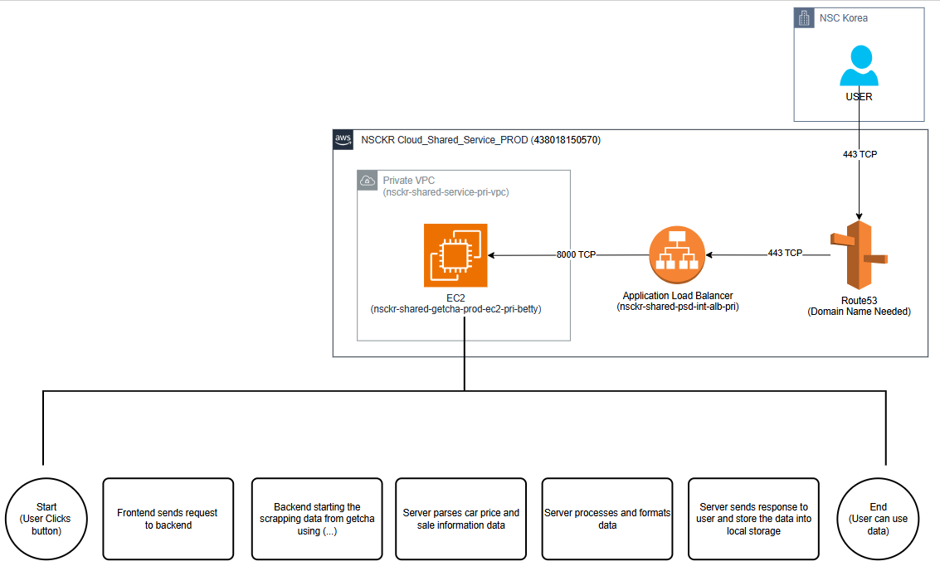
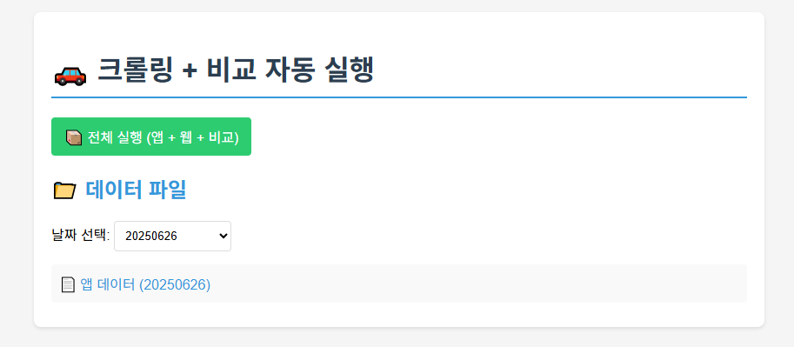
GCS (GETCHA Scraper) Development
Python-based web scraper (Similar to RPA) that automatically collects discount information for imported car brands from the GETCHA website (mobile) and saves the data as an Excel file.
https://gcs.bmwkr.ap-northeast-2.aws.cloud.bmw/

Slide 9
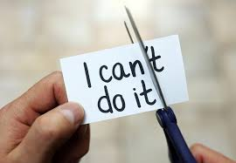
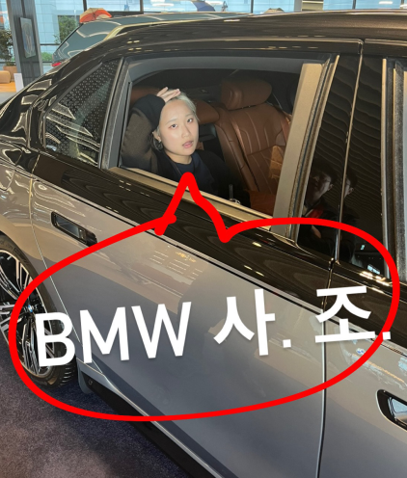
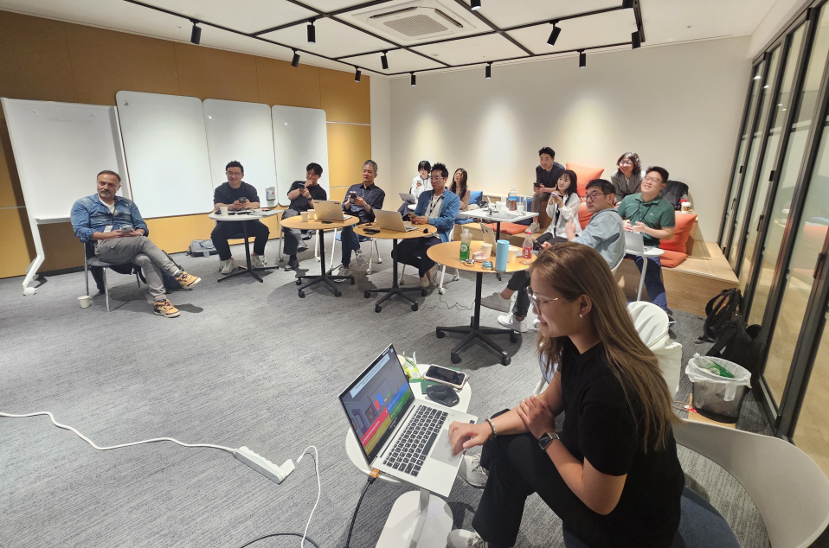

What I’ve gained
CONFIDENCE
The most valuable thing I’ve gained.
Love with IT.
As my career path.
Love with BMW
The GOAT.

Slide 10
IT INFRASTRUCTURE RYU DONGHYUN
FG-AP-52

Slide 11
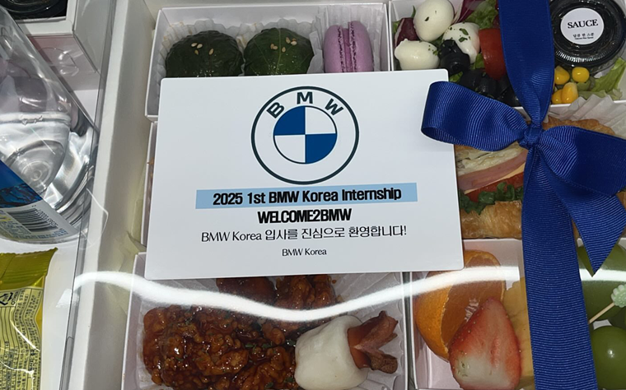
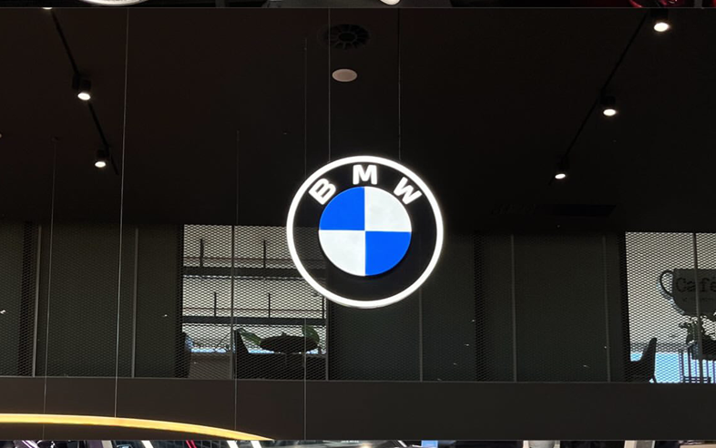
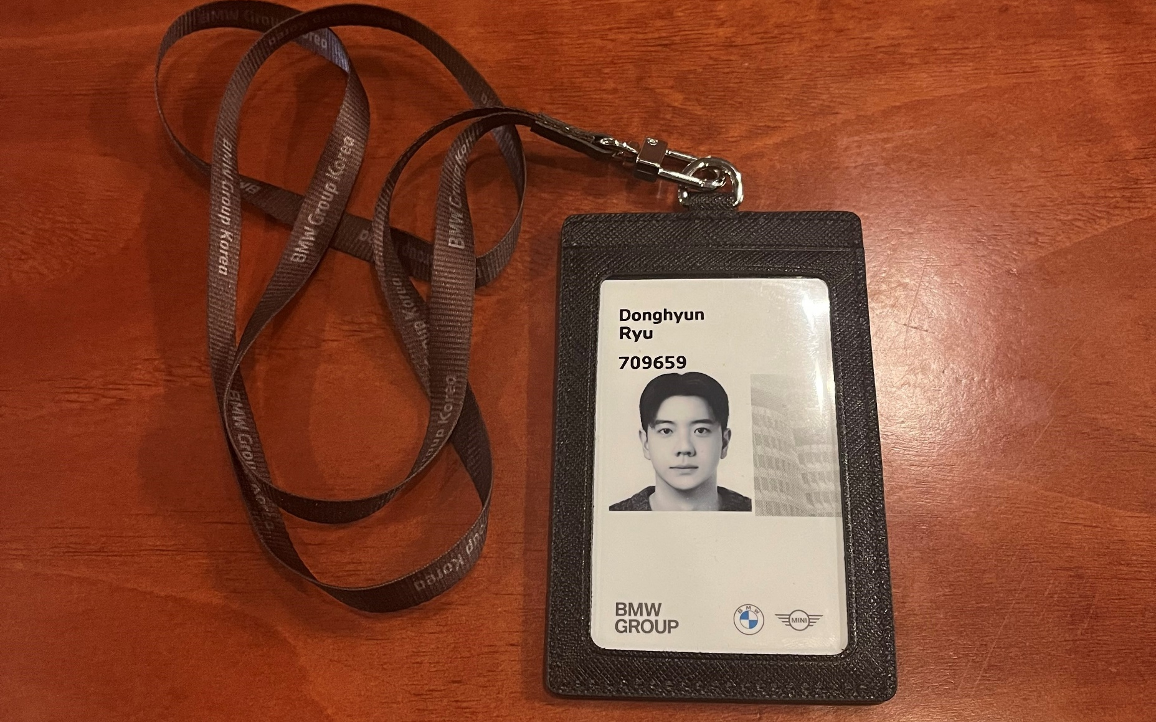
My goals for the internship
GAINING WORK EXPERIENCE
UNDERSTANDING THE INDUSTRY
PERSONAL GROWTH
6 MONTHS OF INTERNSHIP Through long-term work engagement, cultivate practical contributions and practical work skills.
FG-AP-52 INTERN Directly experience the infrastructure processes as an intern in the INFRASTRUCTURE department. Strengthening Infrastructure Skills
BMW KOREA As an intern at BMW, the leading luxury car company, have a unique and competitive opportunity for industry experience.
Mobility MARKET Learning about the automative industry. Understanding of the mobility industry
ONE STEP CLOSER TO SOCIETY Preparing to step out of school and into society.
ENSURING MY CAREER PATH Reconfirming my job skills, interests, and aptitudes. Personal growth and career exploration

Slide 12

What I’ve done Over the Past 6 Months
Budget Handling
GAIA

Slide 13
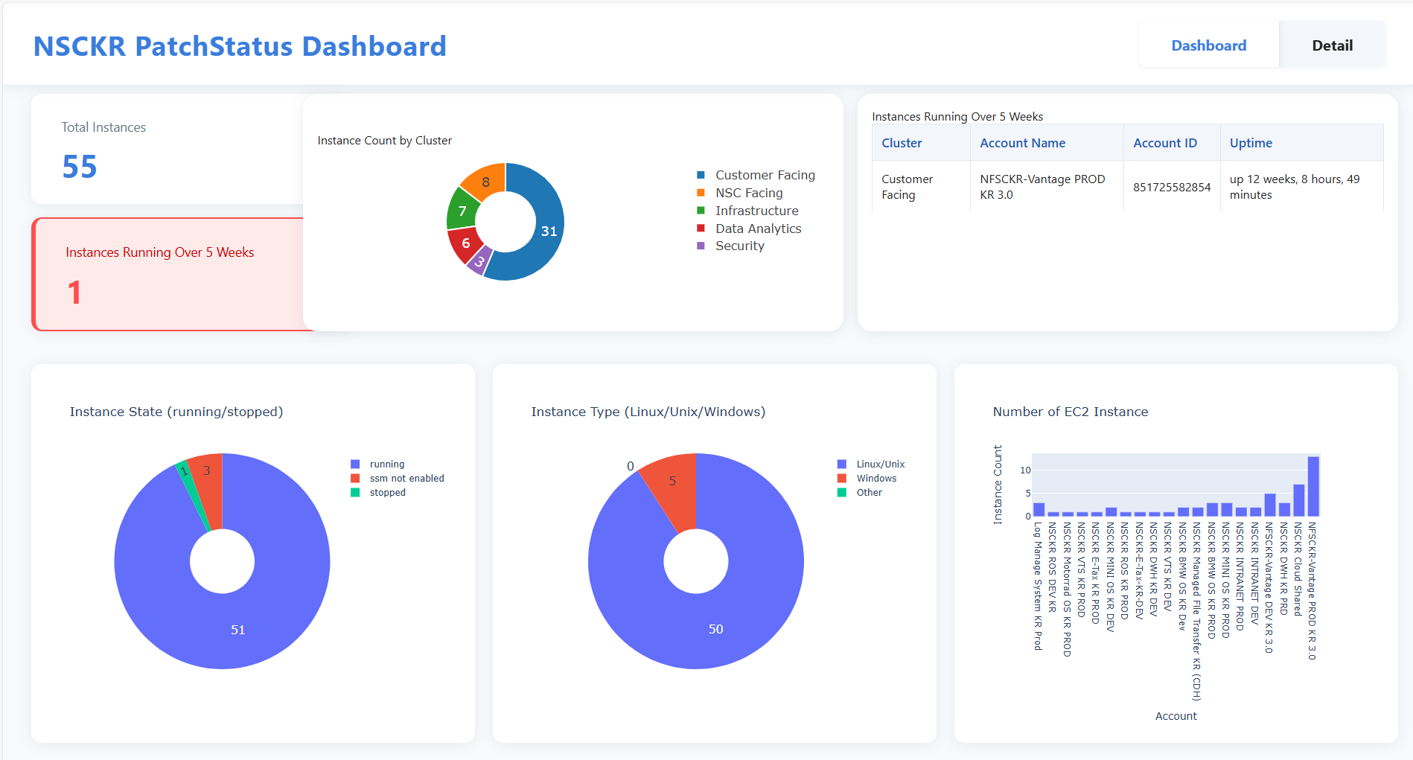
What I’ve done Over the Past 6 Months

Slide 14
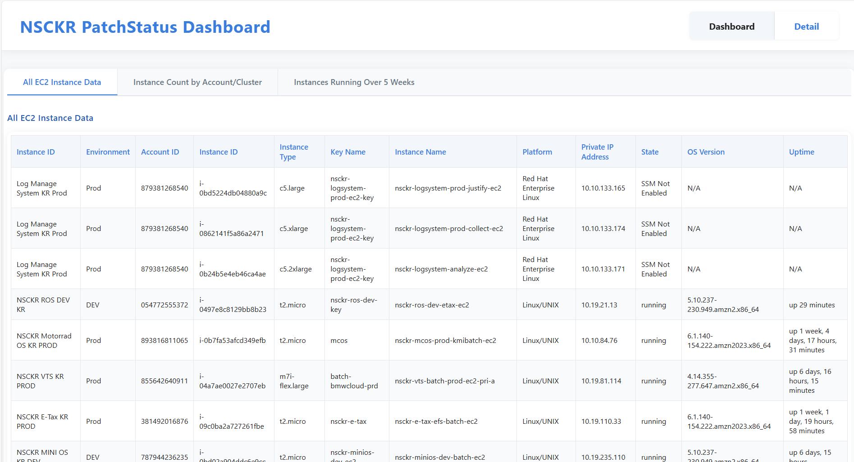
What I’ve done Over the Past 6 Months

Slide 15
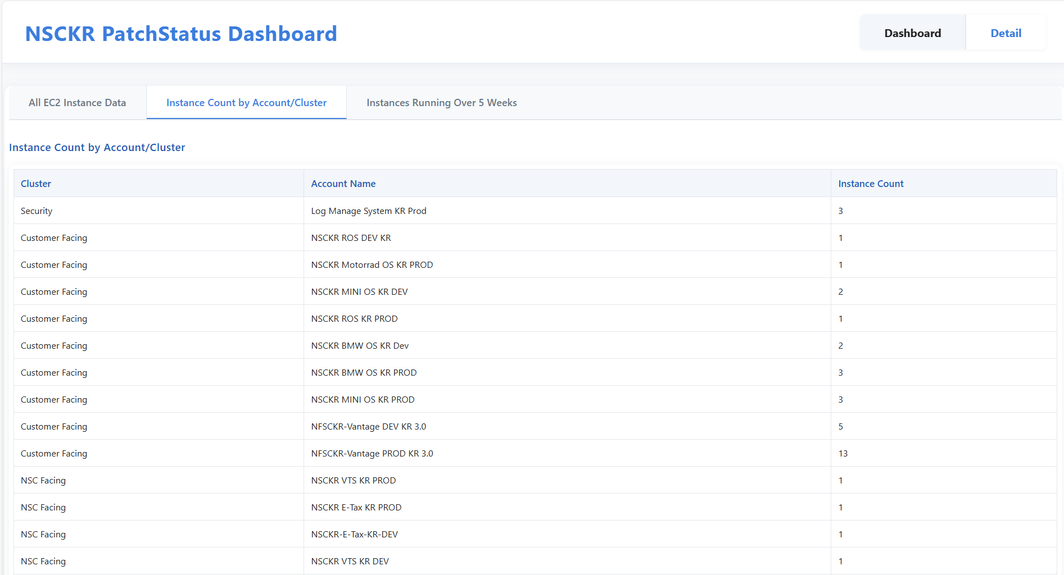
What I’ve done Over the Past 6 Months

Slide 16
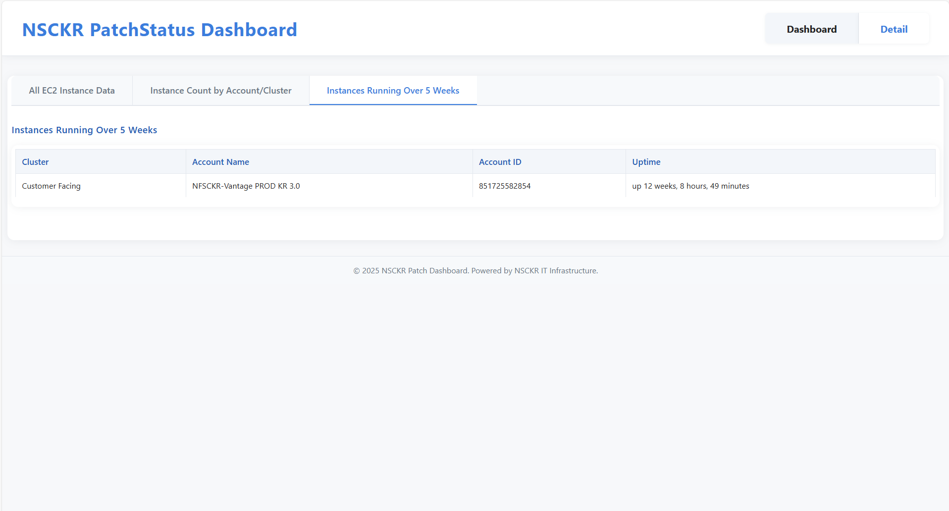
What I’ve done Over the Past 6 Months

Slide 17
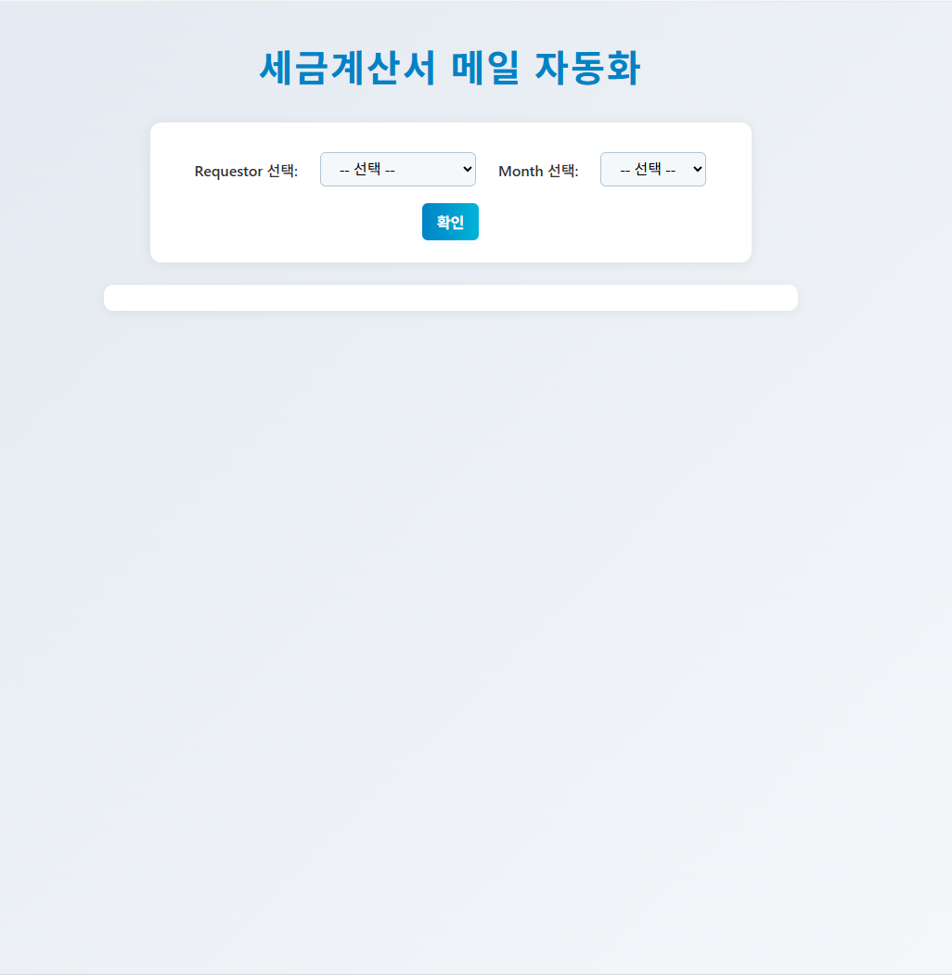
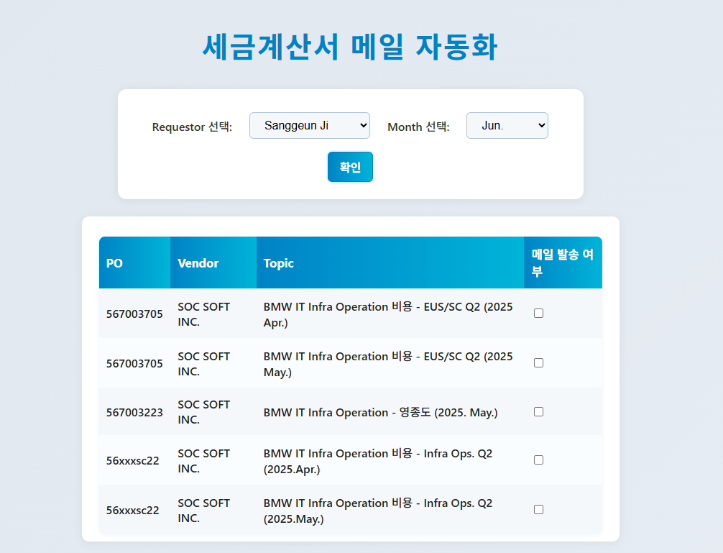
What I’ve done Over the Past 6 Months

Slide 18
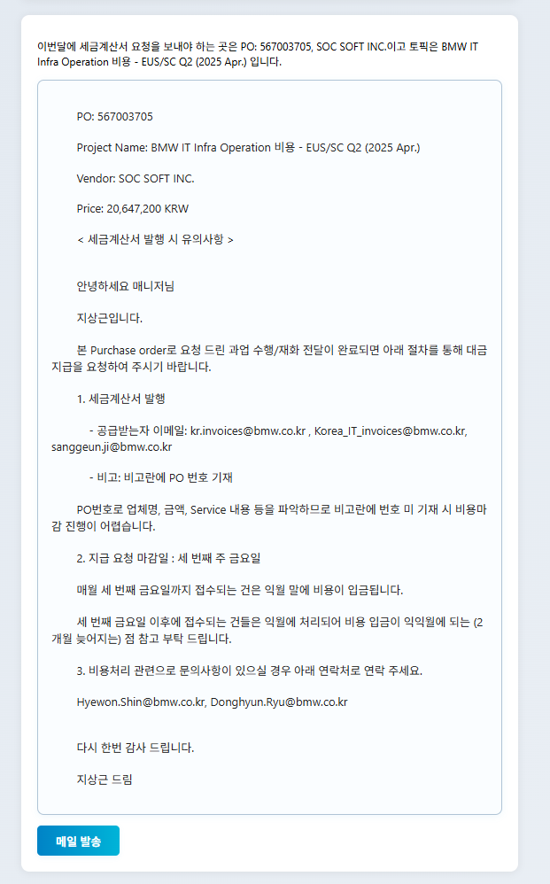
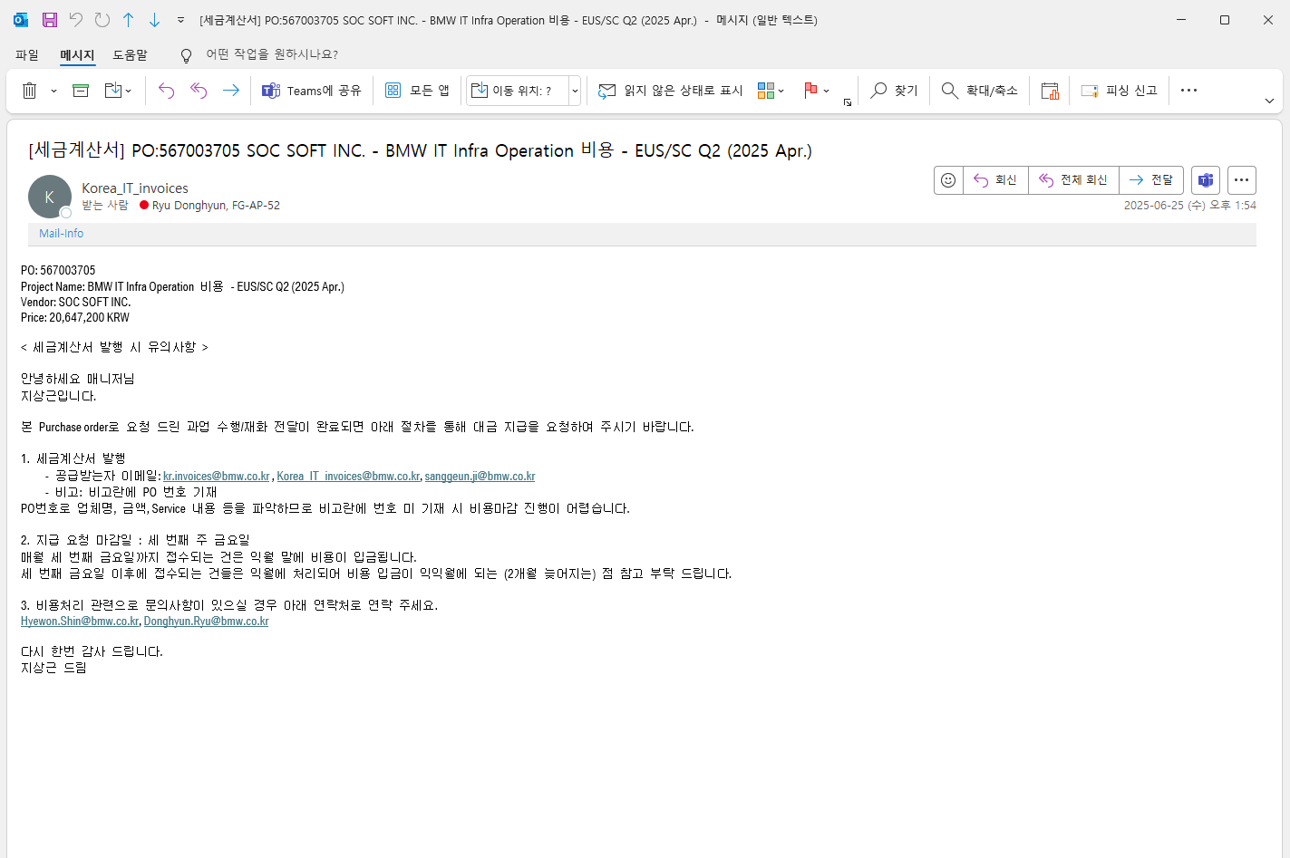
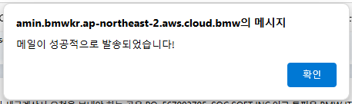
What I’ve done Over the Past 6 Months

Slide 19
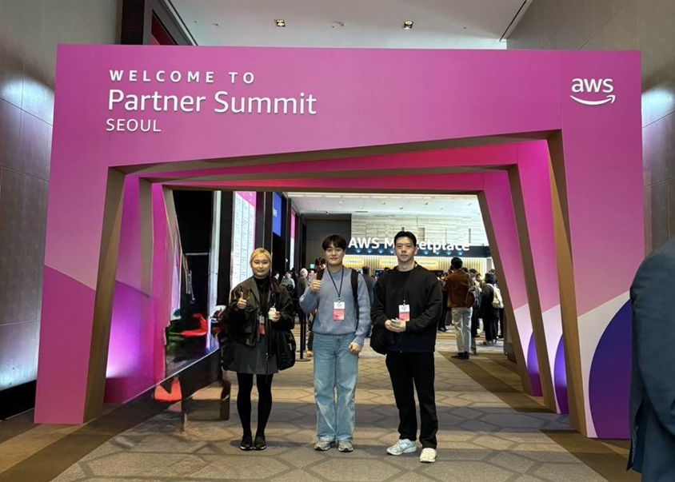
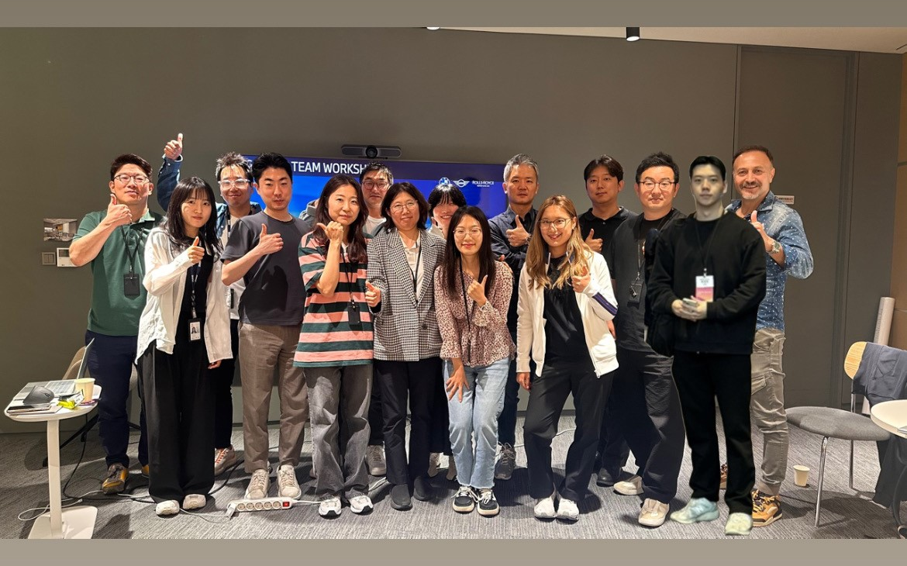
Memorable moments at bmw
AWS SUMMIT
VDC/D.C SITE VISIT
Great team
AWS Seminar The AWS Semiar inspired me to see the power and potential of cloud&AI technology
Career Direction Decided to pursue a career in cloud and AI after hearing inspiring sessions. The Seminar and Summit played a key role in shaping my future path
VDC Observing the vehicle release process at BMW VDC gave me a real sense of belonging in the automotive industry
D.C.
Visited the BMW Driving Center, experienced the M-Taxi ride, and saw various BMW models up close
WITHIN THE OFFICE Everyone was kind , supportive, and always willing to teach me Thanks for their guidence
OUTSIDE THE OFFICE
Enjoyed warm hospitality through coffee chats and shared meals a welcoming atmosphere beyond work

Slide 20



Achievements, Experiences, and Goal Attainment
GAINING WORK EXPERIENCE
Gained hands-on experience in budgeting and financial processes using SAP systems
Supported cloud infrastructure operations and enhanced system management skills
Developed automation systems using AI technologies
UNDERSTANDING THE INDUSTRY
Experienced how the automotive industry operates from production to delivery
Observed the role of IT in supporting manufacturing, logistics, and business processes
Realized the importance of digital transformation within automotive companies
PERSONAL GROWTH
Enhanced technical development skills through real-world projects and systems
Improved communication and collaboration by working with diverse teams
Learned how to adapt professionally in a corporate environment

Slide 21
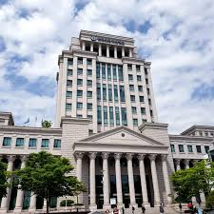




MY Future Plans
GO BACK TO SCHOOL & GRADUATE
Master’s Program
KEEP PURSUING MY DREAM
Cloud Engineer
Health

Slide 22
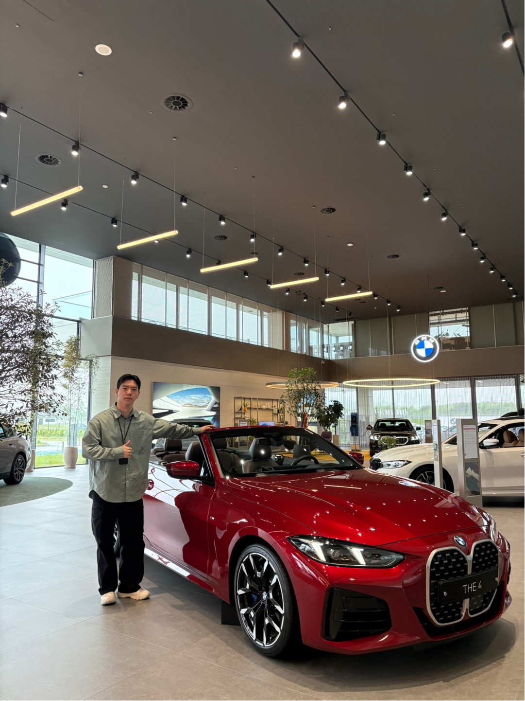
Gratitude and reflection as I say good bye
It was a valuable six months, more enriching than any experience and more meaningful than any time.
I will strive until the day I become a BMW owner!

Slide 23


2025 1h Interns wrap-up
THANK YOU, IT TEAM !
신혜원 (Shin Hyewon)
류동현 (Ryu Donghyun)
“ Couldn’t be any better.”
“ Gearing up for G.O.A.T ”

Slide 24
Message to Us

